Slide 1
Compared to Whom?
Reference bias is driven by role models
Notes:
Hello, I am Ben, a third year PhD Student working with Angela, and I would like to present to you some of our past published work on reference bias, some unpublished results, and a proposed third study.
I would love to get your thoughts on our proposed experiment.

Slide 2

How much self-control do you have when it comes to exercise?
A little
A medium amount
A lot
0
1
2
3
4
5
6
7
8
9
10
Notes:
Take a moment to see this item and choose a response option. How did you come up with an answer?

Slide 3
How do we answer questionnaires?
I have a lot of self control when it comes to exercise
Comprehension
Retrieval
Judgment
Response
Editing
“What does it mean to ‘have a lot of self-control when it comes to exercise’?”
“What are times when I have behaved like this or unlike this?”
“What do these memories mean?
Putting them all together, do I have self-control for exercise?”
“I should respond with ‘Somewhat like me’”
“I don’t want to seem lazy, I better respond with
‘Very much like me’”
Duckworth & Yeager (2015), Tourangeau et al., (2000), Schwarz et al., (2001)
Notes:
Dominant models in survey methods suggest that answering an item, like we did at the start of the talk, is a five-stage process.
In the first step, we must comprehend what the words we are reading mean. What does it mean to be a HW.
Then, we must recall the relevant memories to respond to the item. A student answering a q might think back and remember times when she behaved like a hard worker, and times when she did not.
Then, all of these memories must be integrated into a summary judgment. Putting them all together, would I consider myself a hardworker.
Then this judgement needs to be mapped into one of the reponse options. A student might consider translating their summary judgment inot the repsose somewhat like me
Finally, if there are incentives to do so, respondents might edit their responses to self-present. In our example, the student might change her response from somewhat like me to very much like me to avoid seeming lazy,

Slide 4
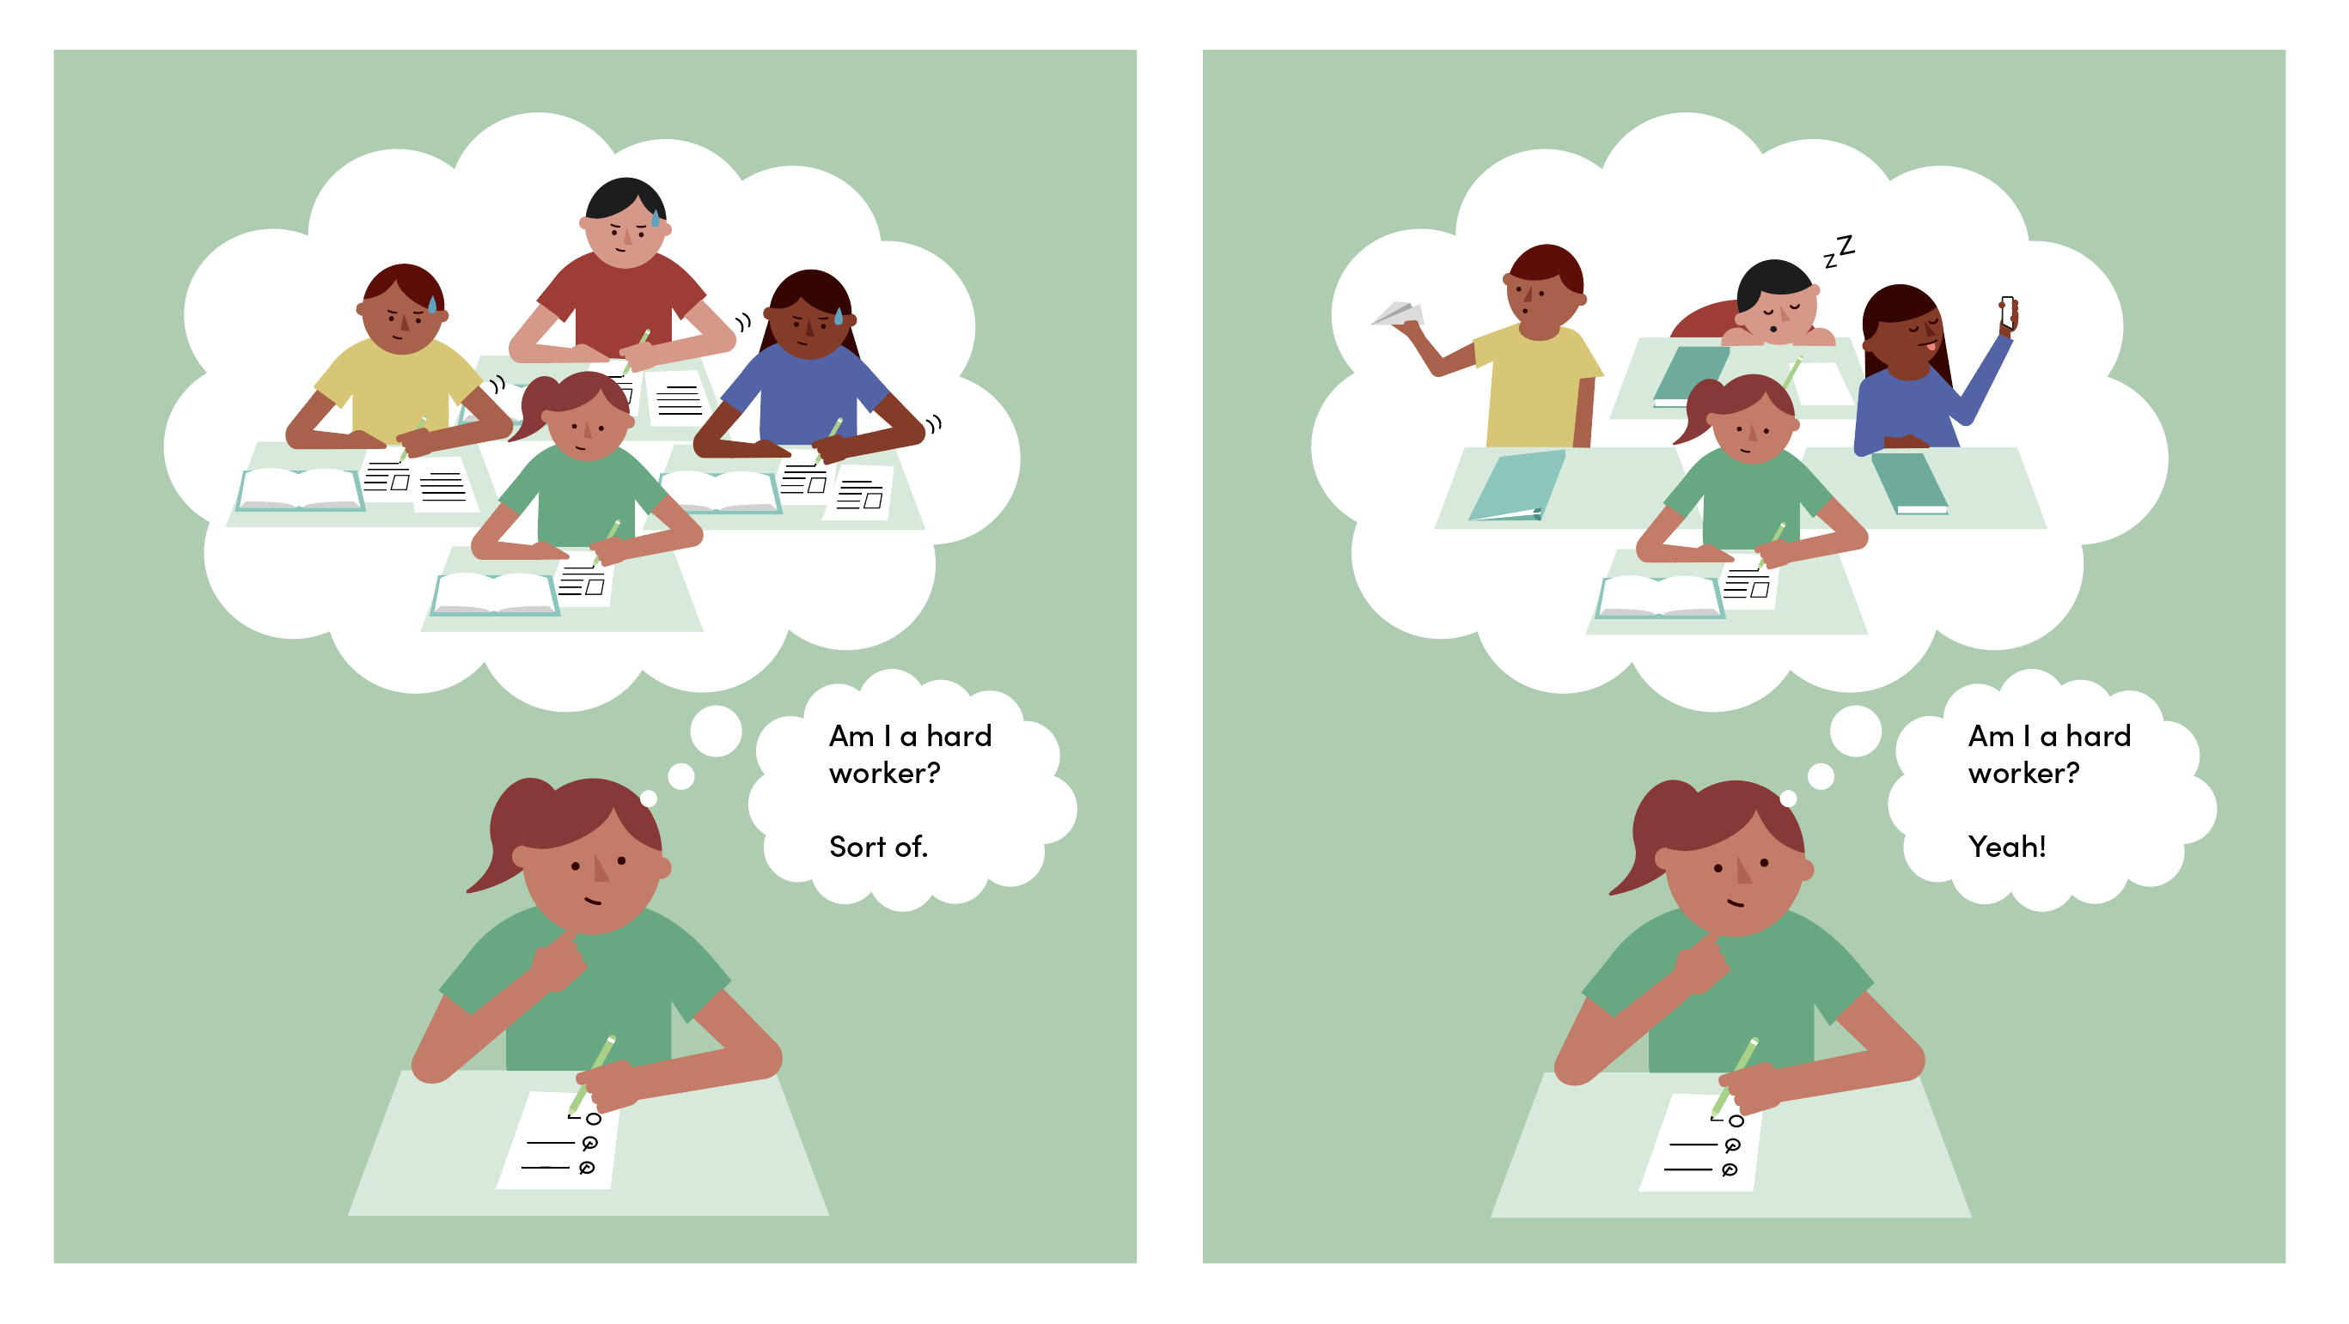
Thanks
Notes:
Imagine a student answering the very same question, just like you did. To respond to such a question, you must bring certain information to memory

Slide 5
Thanks
Notes:
One particularly interesting memory, might be of how this student compares to other students in her grade. In this case, all of her classmates are usually very hard-working, and in comparison, she might consider herself to be

Slide 6
Thanks
Notes:
Only sort of a hard worker.

Slide 7
Thanks
Notes:
Now consider the case on the right. Comparatively speaking, the student now seems like much more of a hardworker.

Slide 8
Thanks
Notes:
And even if she is equally hardworking in the left and the right, she might now say she definitely is a hard worker.

Slide 9
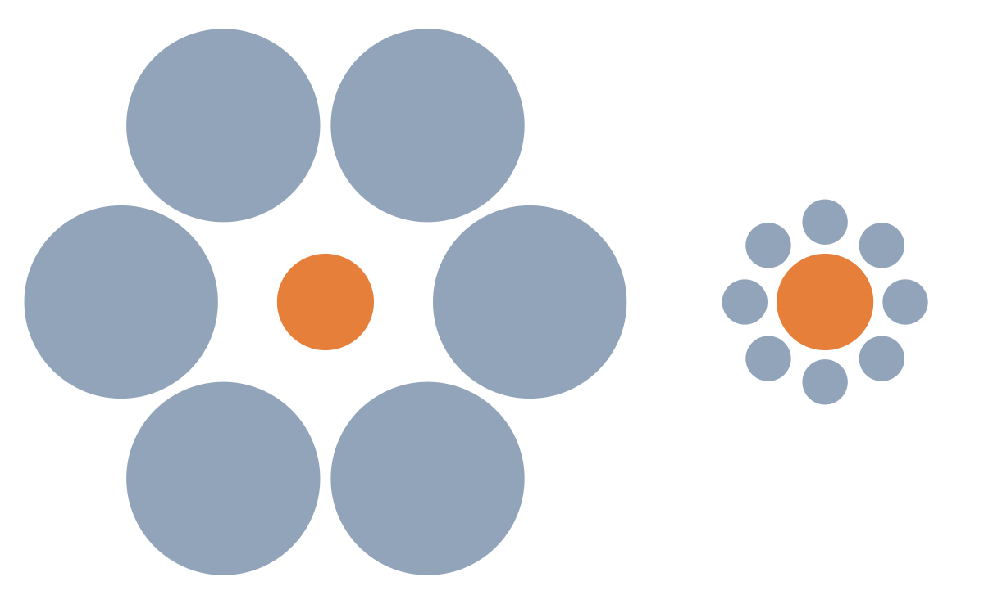
What is reference bias?
Duckworth & Yeager (2015), West et al., (2016), Lira et al., (2022)
Notes:
In the same way in which visual perception is affected by the objects in the background

Slide 10
What is reference bias?
Reference bias is systematic error that arises when participants use different implicit standards to judge their behavior when responding to the same questionnaire items
Duckworth & Yeager (2015), West et al., (2016), Lira et al., (2022)
Notes:
Our perceptions of ourselves will be affected by those around us, and the reference poins, or standards, they produce in our minds.
Reference bias is …
This means that two people with the same level of a trait may report differently if they do not share the same reference points.

Slide 11
If a person has a lot of self-control when it comes to exercise, how many minutes per day would you guess they work out?
0
10
20
30
40
50
60
70
80
90
100
Average minutes per day
Notes:
Take a moment to see this item and choose a response option. How did you come up with an answer?

Slide 12
Standards
Self-Reported
Self Control
Own Behavior
Bandura (1971); Cialdini (2007); Sacerdote (2011)

Slide 13

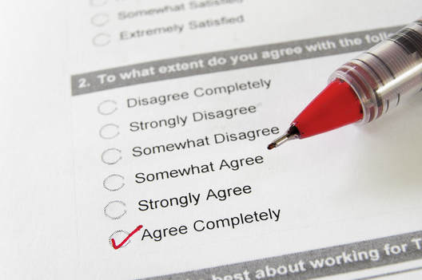
KIPP charter schools increase test scores and college enrollment but not self-reported self-control
West et al., (2016); Dobbie & Fryer (2015); Tuttle et al., (2013,2015)
Notes:
Early evidence for reference bias came from experimental evaluations of charter schools. schools are oversubscribed and select students by lottery, which means that comparing students admitted to those who participated in the lottery and were not selected and went on to public school provides a test of the causal effects of charter schools. Results from these evaluations suggest that charter schools
increase objective outcomes such as test scores and college enrollment, despite
not increasing self-reported self control. There are two potential explanations. Either charter schools change behavior without changing underlying personality, or reference bias obscures the effect because charter schools also raise the reference points students use to judge themselves.

Slide 14
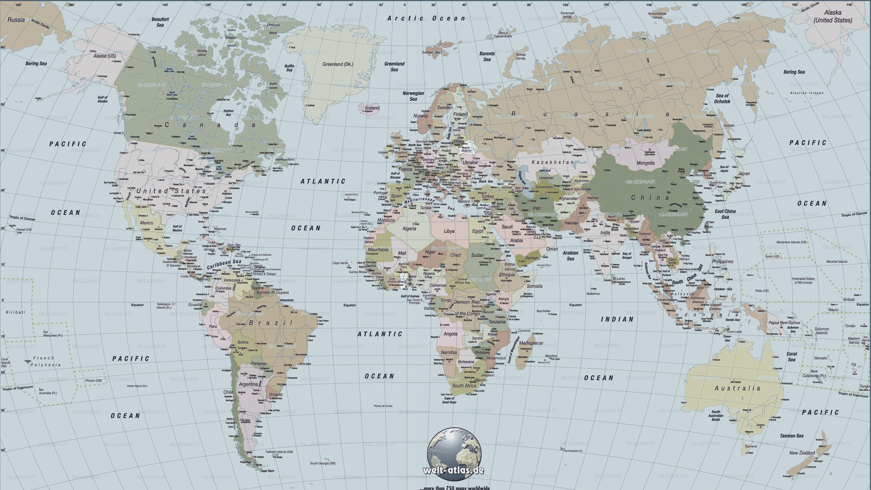
The average Japanese citizen rates themselves as less conscientious than the average American citizen
Mõttus et al., (2012); Schmitt et al., (2007)
Notes:
Similar evidence from cross cultural personality research also provides paradoxical results. In survey studies of over 50 countries, Japanese citizens consistently rate themselves as less conscientious than American citizens. Does this represent true country-level differences in personality, or a measurement artifact?

Slide 15
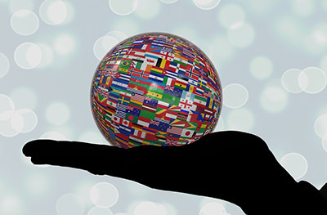

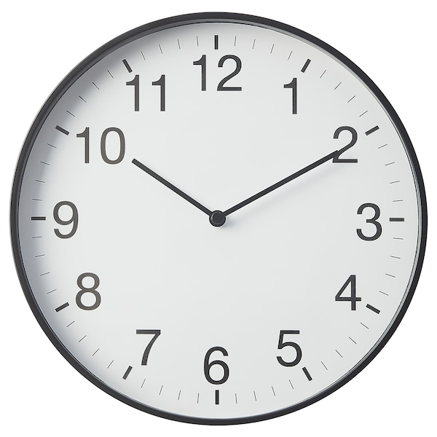
Even though cultural experts and objective markers of conscientiousness negatively relate to self-reports
Peng et al., (1997); Heine et al., (2008); Heine et al., (2002)
Notes:
Research suggests the latter. In one study, the more cultural experts rated a country as having a particular trait, the less the country’s citizens endorsed that trait. In another study, objective markers for conscientiousness at the country level, such as the efficiency of post offices and the accuracy of clocks, negatively correlated to country level self reported conscientiousness. This mismatch between self-reports and other validity criteria points to reference bias.

Slide 16
This evidence might not be conclusive because…
The cultural experts might be biased
Proxies might be not valid
Peng et al., (1997); Heine et al., (2008); Heine et al., (2002)
Notes:
However, this evidence might not be conclusice.
In the first case, the cultural experts might be biased.
In the second, the behavioral proxies used might not be valid.
To rule our whether these are measurement effects or not, it may be useful to understand the cognitive processes of questionnaire responding.

Slide 17
How do we answer questionnaires?
I am a hard worker.
Comprehension
Retrieval
Judgment
Response
Editing
Compared to whom?
Against what reference point?
Morina (2021), Mussweiler et al., (2003), Kahnemann (1992)
Notes:
While we know a lot about biases in the editing and the response stage, like faking and acquiescence, we know less about the other stages. While reference bias permeates the questionnaire response process, I suggest that it mainly enters at the judgment stage.
We know from the Judgment and Decision-Making literature that all judgment is comparative, and that anchors can substantively change our decisions. In that vein, when we integrate all the trait relevant memories into a summary judgment, we must make that judgement in comparison to a reference point, or a standard.

Slide 19
Evidence for reference bias within schools in a natural experiment in Mexico
Lira et al., (2022)

Slide 20
Evidence for reference bias within schools
Conscientiousness
Standards
Lira et al., (2022)

Slide 21
Task measures of self-regulation are not contaminated by reference bias
Lira et al., (2022)

Slide 22
Where do standards come from?
Notes:
Take a moment to see this item and choose a response option. How did you come up with an answer?

Slide 23
Think of a close friend with whom you spend a lot of time. How many minutes per day would you guess they work out?
0
10
20
30
40
50
60
70
80
90
100
Average minutes per day
Notes:
Take a moment to see this item and choose a response option. How did you come up with an answer?

Slide 24
Think of someone you know who has a lot of self-control when it comes to exercise. How many minutes per day would you guess they work out?
0
10
20
30
40
50
60
70
80
90
100
Average minutes per day
Notes:
Take a moment to see this item and choose a response option. How did you come up with an answer?

Slide 25
Friend Behavior
Standards
Self-Reported
Self Control
Role Model Behavior
Own Behavior
Bandura (1971); Cialdini (2007); Sacerdote (2011)

Slide 26
How many minutes per day do you work out?
0
10
20
30
40
50
60
70
80
90
100
Average minutes per day
Notes:
Take a moment to see this item and choose a response option. How did you come up with an answer?

Slide 27
Study 1
Initial evidence for role models in a study of 1100 adolescents over 2 years

Slide 28
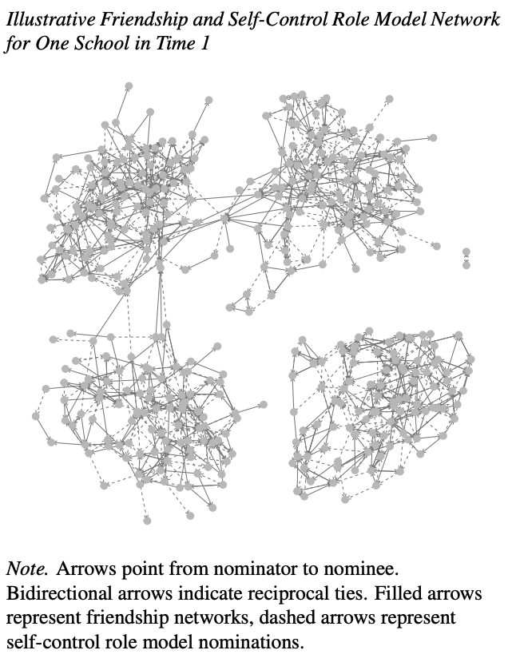
Networks of friendship and role models are distinct
20% of cross nomination
Low (and decreasing) correlation of both networks.
High reciprocity in friend networks, low reciprocity in role model networks
Low correlation of centrality measures across networks.

Slide 29
Exemplars have higher GPA than the ego

Slide 30
Evidence that role models—not friends–account for reference bias

Slide 31
But the opposite is true for student grades

Slide 32
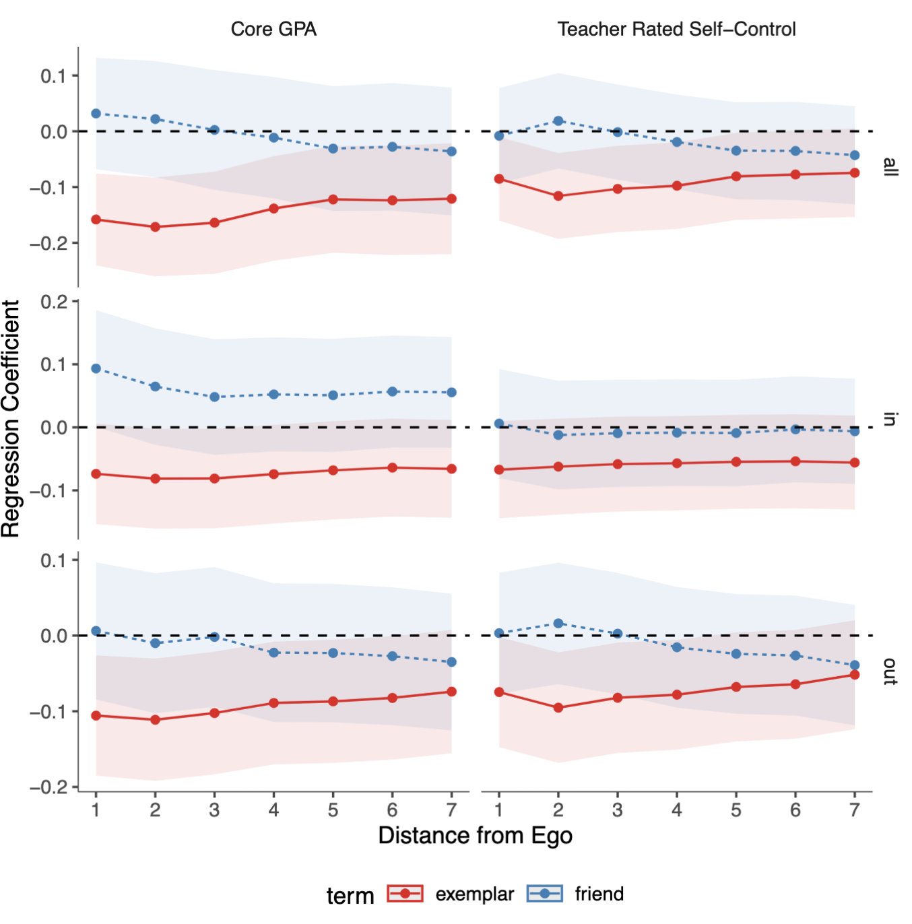
And the effect is driven by close outgoing ties

Slide 33
Discussion
Friends’ and role models’ objectively measured behavior differentially relates to behavior and self-ratings of self control
Limitations
Do the findings generalize to other domains?
Do the findings generalize to other age groups?
What is the mechanism?

Slide 34



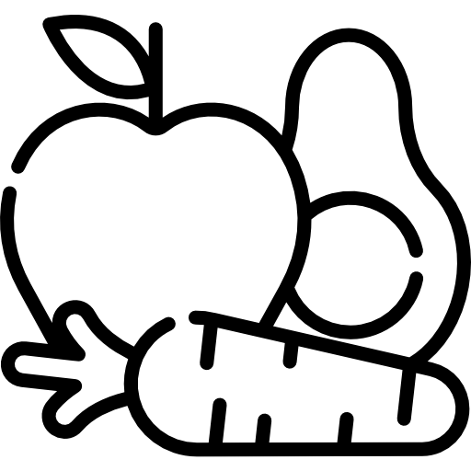

Study 2
Pre-registered replication and extension in a sample of adults in six domains

Slide 35
Method
5,432 Prolific participants assigned to one of six domains
Exercise, Saving, Healthy eating
Punctuality, Social media distraction, Bedtime procrastination
Nominated 2 friends and role models
Self reported their behavior, standards, and self-ratings of self-control
Estimated their friend’s and role model’s behavior.
We estimated how friends’ and role models’ behavior related to a person’s behavior, standards, and self-ratings of self-control

Slide 36
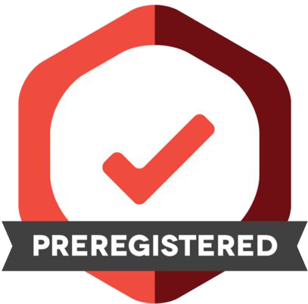
Role models matter twice as much than friends for standards
Friend Behavior
Standards
.21
-.25
.44
Self-Reported
Self Control
.24
.28
Role Model Behavior
Own Behavior
.66
.16

Slide 37
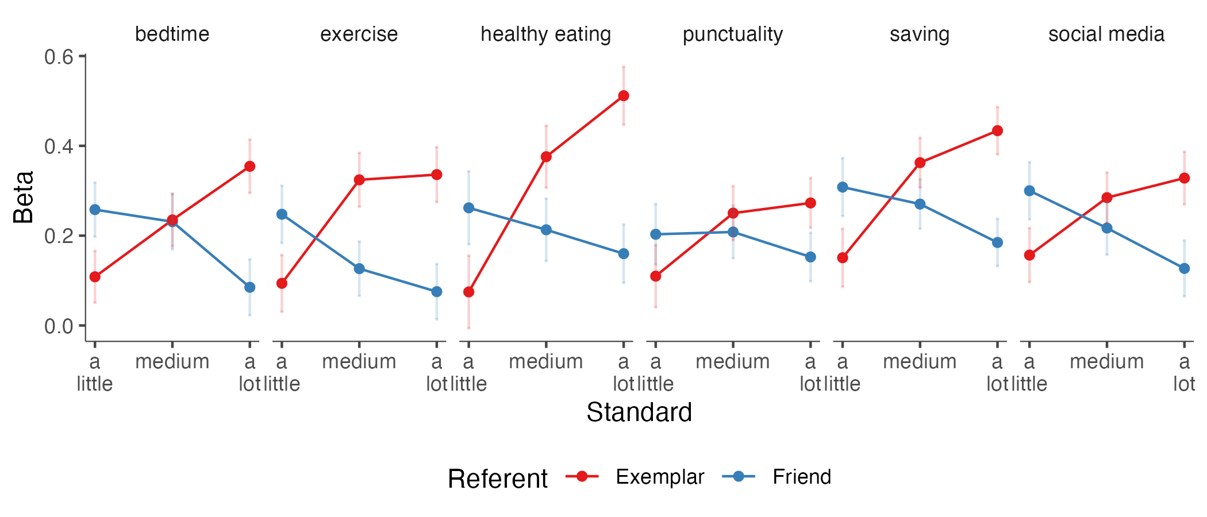
Role models set the high standards, and friends the low standards

Slide 38
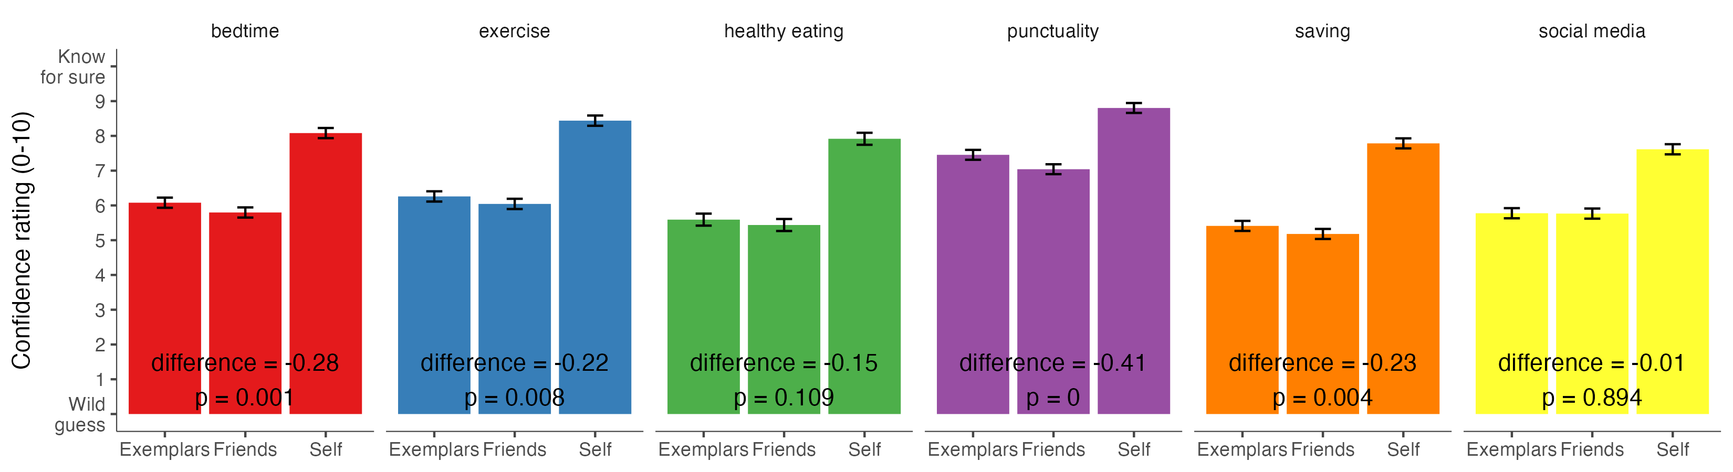
Results are not explainable by differences in ease of judgement

Slide 39
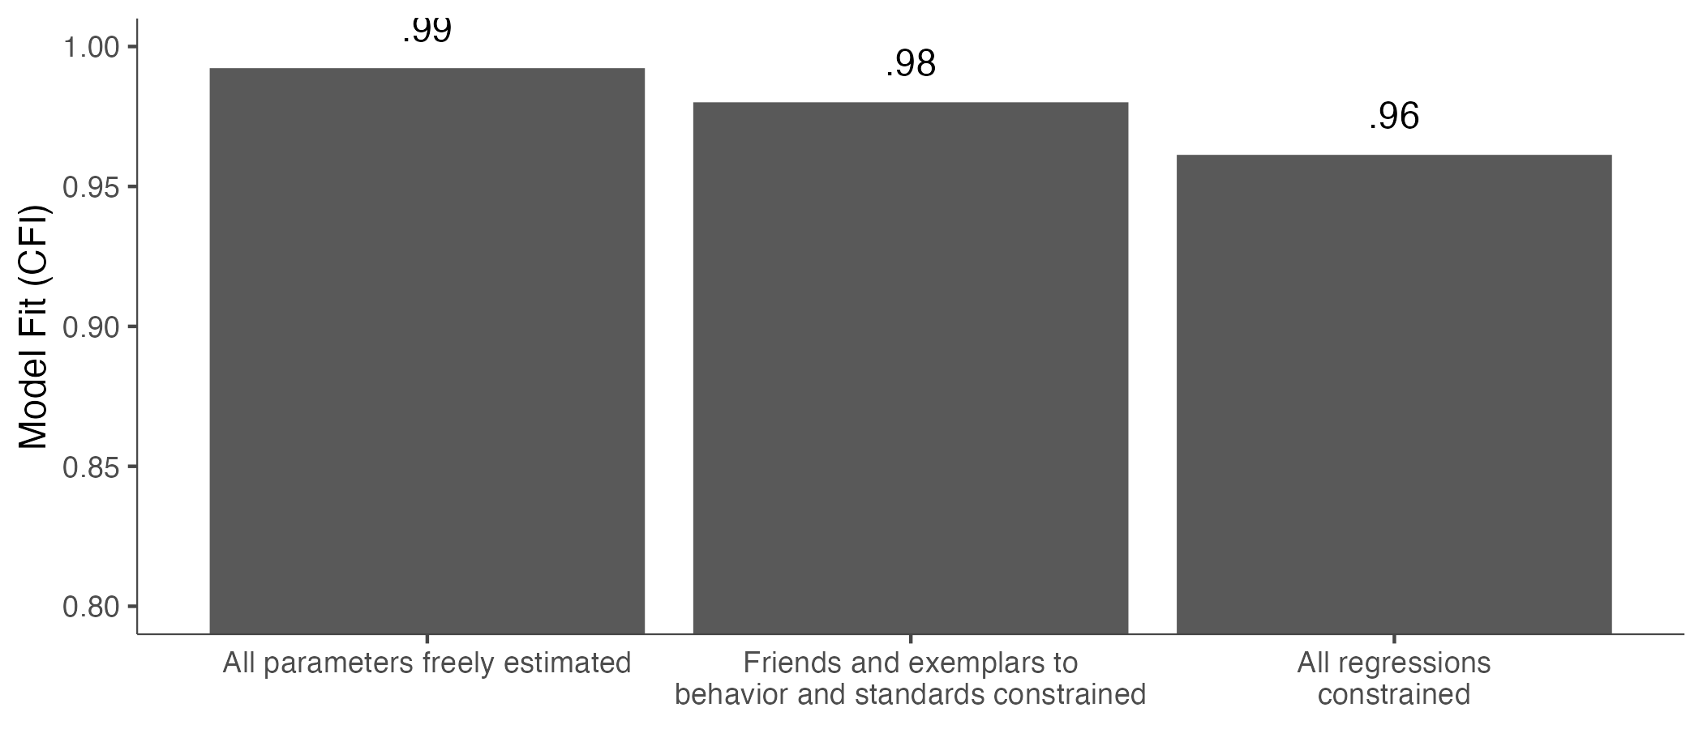
Results are moderated by the domain

Slide 40
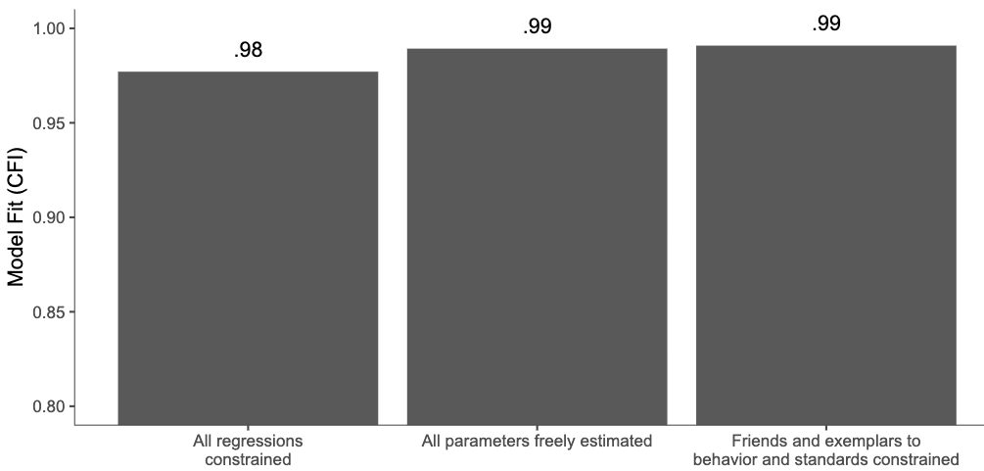
Results are not moderated by domain importance

Slide 41
Discussion
We show that results generalize other domains and ages
Is the effect causal?
Without manipulation of variables, we cannot know!
But we cannot manipulate people’s friends and role models.

Slide 42
Proposed Study 3
Experimental evidence for role models

Slide 43
How many minutes per day do you work out?
0
10
20
30
40
50
60
70
80
90
100
Average minutes per day
Notes:
Take a moment to see this item and choose a response option. How did you come up with an answer?

Slide 44
How many minutes per day do you work out?
20
Average minutes per day
Notes:
Take a moment to see this item and choose a response option. How did you come up with an answer?

Slide 45
Think of a friend and someone else you know
Friend: John
Other person: Stacy
Notes:
Take a moment to see this item and choose a response option. How did you come up with an answer?

Slide 46


Imagine you just learned that
Friend: John
Exercises
Other person: Stacy
Exercises
10
30
Average minutes per day
Average minutes per day
Notes:
Take a moment to see this item and choose a response option. How did you come up with an answer?

Slide 47
Imagine you just met two people
John
Exercises
Stacy
Exercises
10
30
Average minutes per day
Average minutes per day
Notes:
Take a moment to see this item and choose a response option. How did you come up with an answer?

Slide 48
Imagine that a year goes by. John becomes a close friend. You see Stacy a couple of times and she seems very self-controlled for exercise
John
Exercises
Stacy
Exercises
10
30
Average minutes per day
Average minutes per day
Notes:
Take a moment to see this item and choose a response option. How did you come up with an answer?

Slide 49
Four conditions
 | Friend -1 SD | Friend +1 SD
Other person -1 SD
Other person +1 SD

Slide 50
With that in mind…
Notes:
Take a moment to see this item and choose a response option. How did you come up with an answer?

Slide 51
If a person has a lot of self-control when it comes to exercise, how many minutes per day would you guess they work out?
0
10
20
30
40
50
60
70
80
90
100
Average minutes per day
Notes:
Take a moment to see this item and choose a response option. How did you come up with an answer?

Slide 52
How much self-control do you have when it comes to exercise?
A little
A medium amount
A lot
0
1
2
3
4
5
6
7
8
9
10
Notes:
Take a moment to see this item and choose a response option. How did you come up with an answer?

Slide 53
The setup
People are assigned to one of the six domains from before
They self report their behavior
They are asked to imagine that they learn their friends exercise ±1SD, and their role models exercise ±1SD
With that in mind, they now rate their own self-control and their standards for what counts.
We ask people how much the imagined scenario represents their real life

Slide 54
Important decisions
Should we ask people to report their own level of self-control at pre-test?
We get more power, but there might be demand effects, or a desire to be consistent with the previous answer.
What is better, a guess in the present, or imagine a year into the future?

Slide 55
Role models matter more than friends for reference bias
Notes:
Take a moment to see this item and choose a response option. How did you come up with an answer?

Slide 56
Thanks

Slide 57



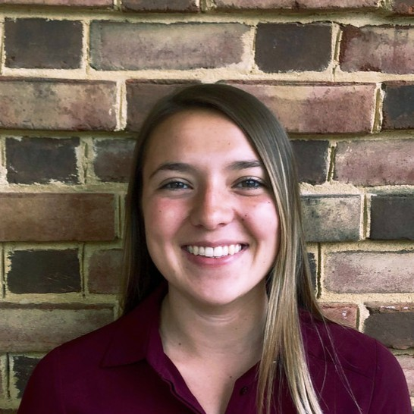
Thank you!
And thanks to
Angela L. Duckworth
David S Yeager, Joseph O’Brien (UT Austin)
Pablo Peña (U Chicago)
Tim Kautz, Amy Defnet, Kate Munkacsy (Mathematica)
Brian Galla (U Pitt)
Sidney D’Mello (UC Boulder)
Peter Meindl (West Point)

Slide 58
Additional Slides

